Slide 1
Image-Based 3D Textured body Reasoning
Yuchen Luo
Shanghai Jiao Tong University

Slide 2
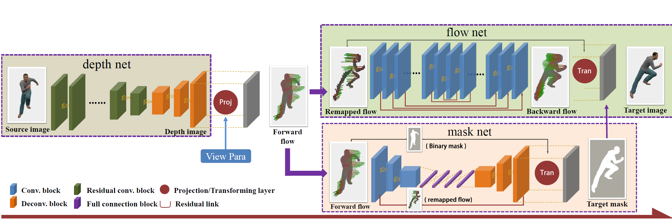
Insight: Novel View Synthesis
View Extrapolation of Human Body from a Single Image (CVPR), 2018
Hao Zhu ; Hao Su ; Peng Wang ; Xun Cao ; Ruigang Yang

Slide 3
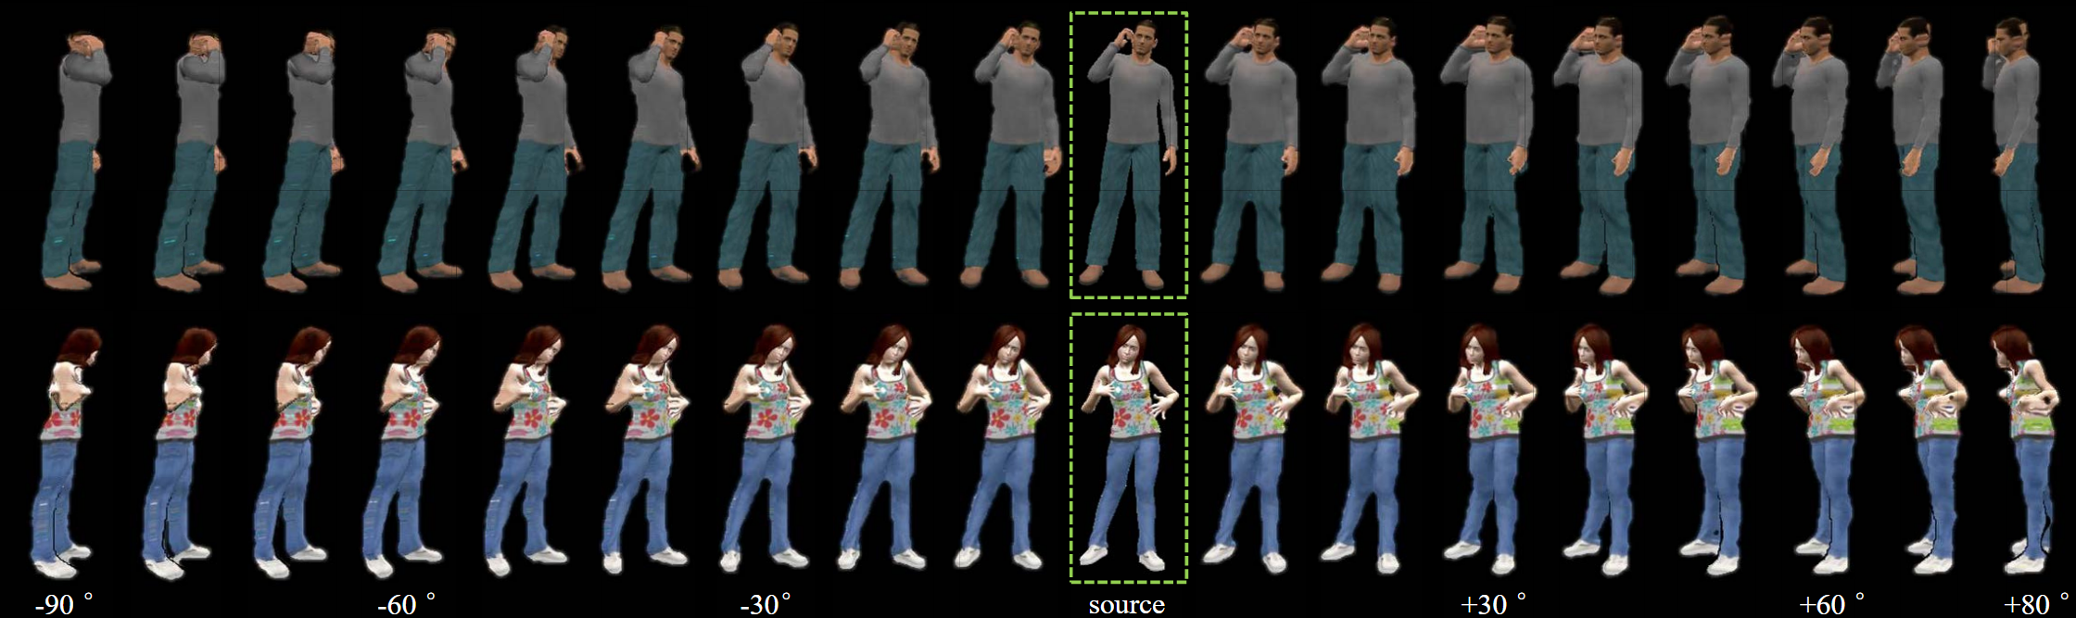
× Implausible result when angle > 90°
× No human prior

Slide 4
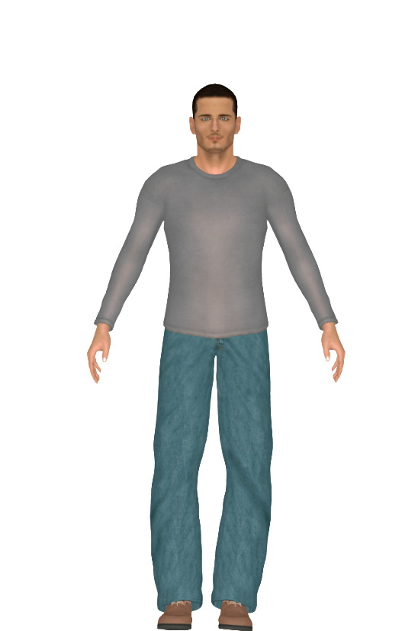
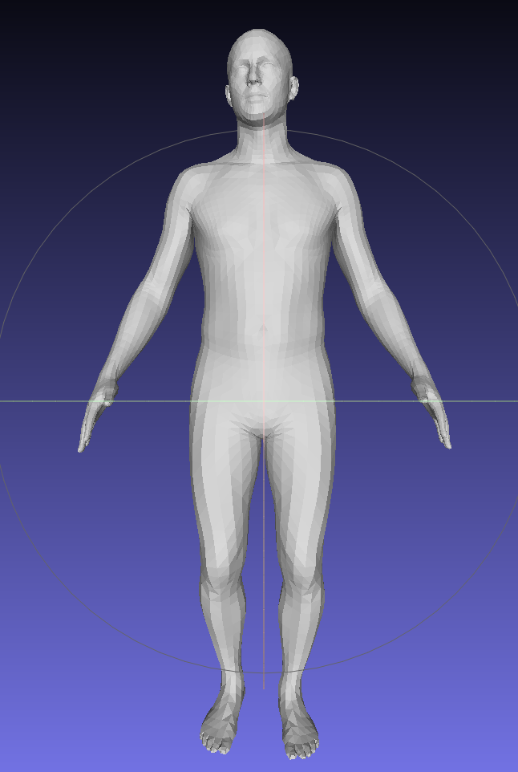
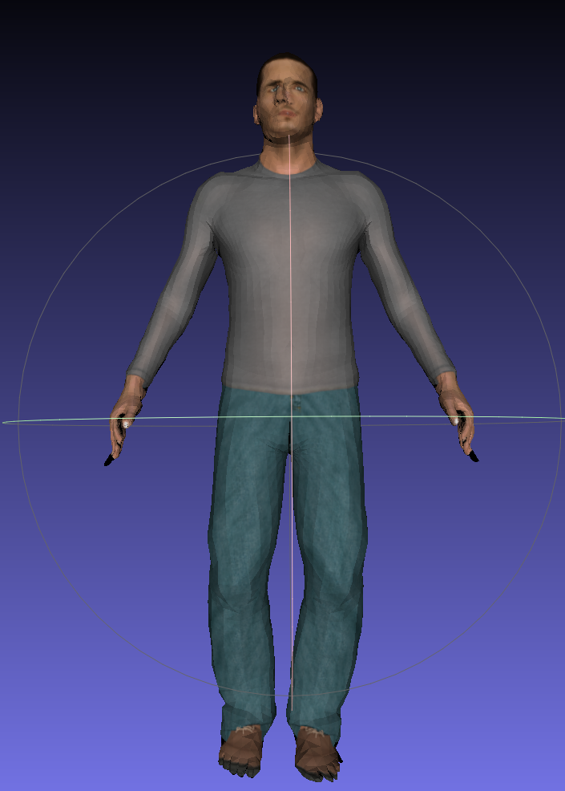
TARGET
RGB
Naked SMPL
SMPL with texture&detail

Slide 5
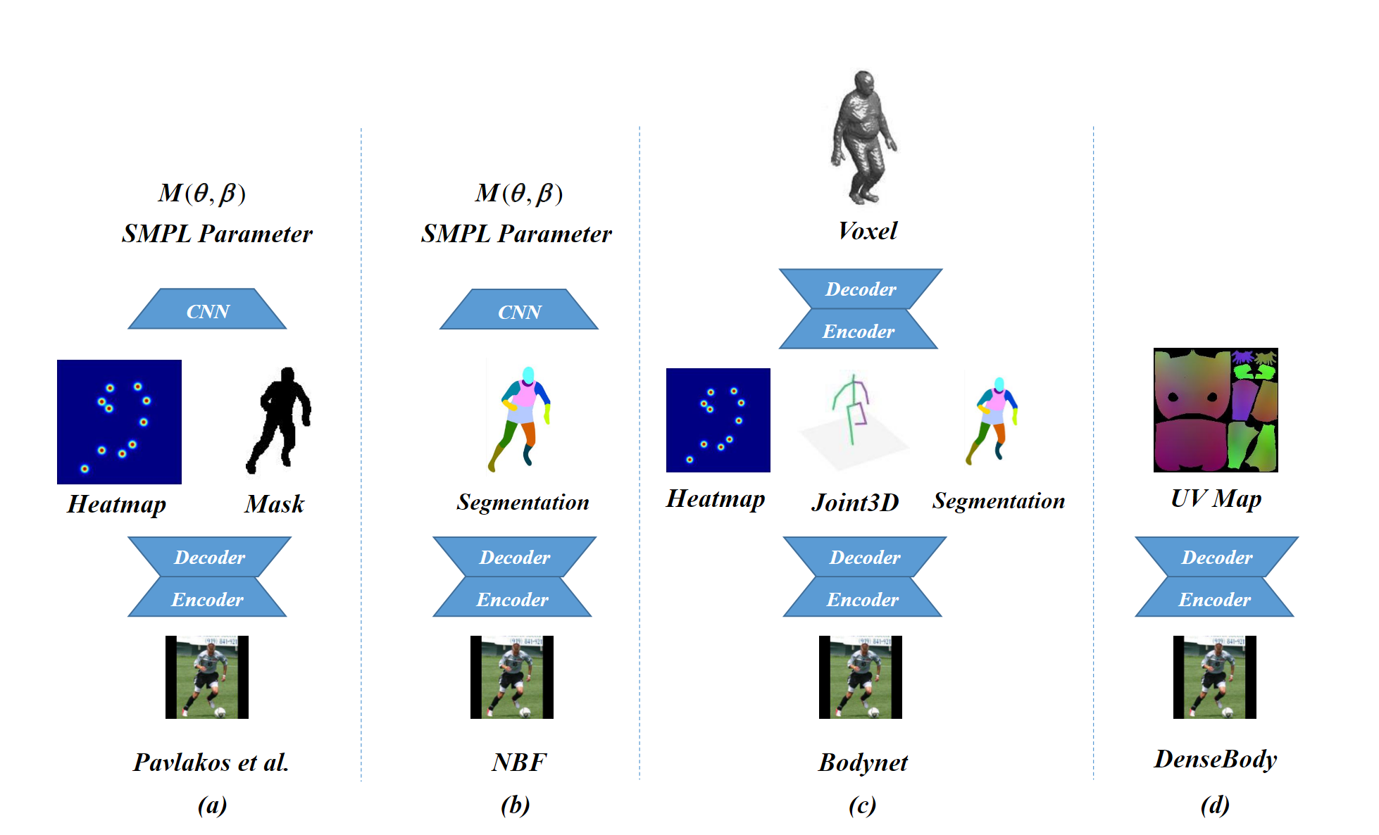
RGB to SMPL
State-of-the-art

Slide 6
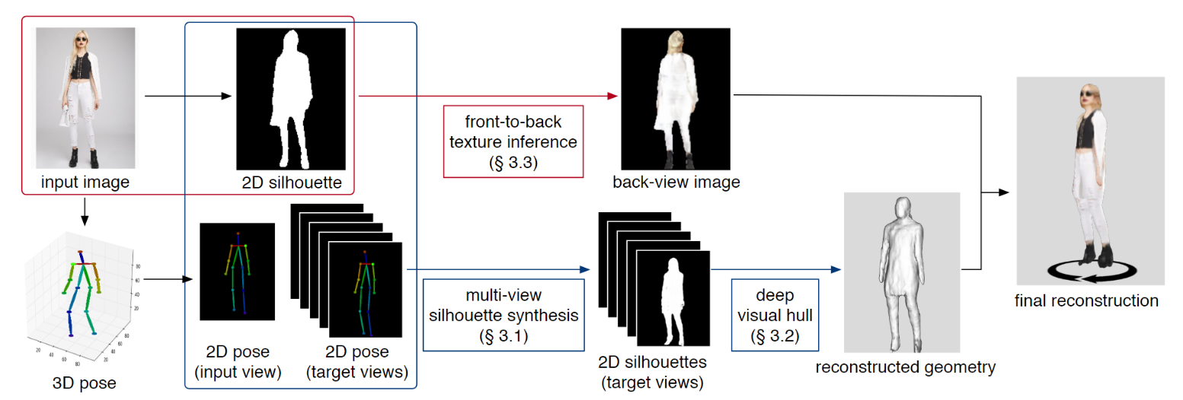
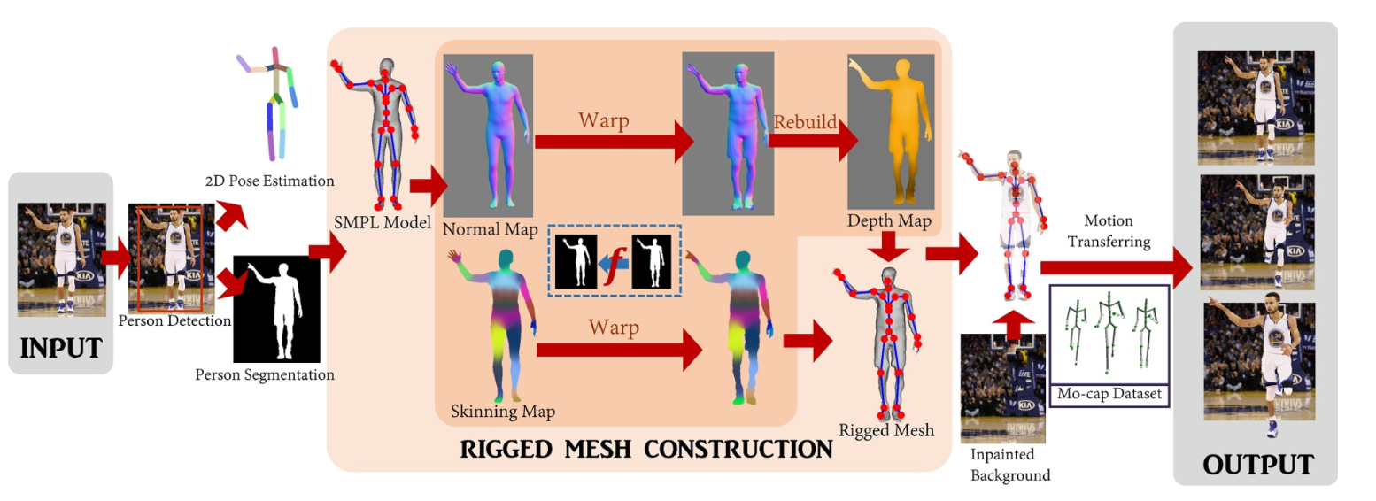
Detailed Model
SiCloPe: Silhouette-Based Clothed People
× No model，No rig
√Front-to-Back Texture Synthesis
Photo Wake-Up:3D Character Animation from a Single Photo
× Human Interaction
× No back texture
√Mean-value Coordinate warping

Slide 7
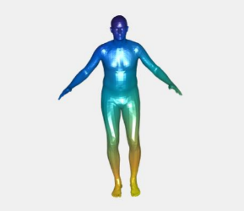
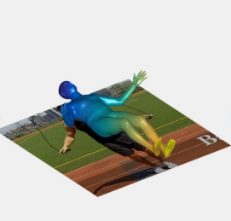
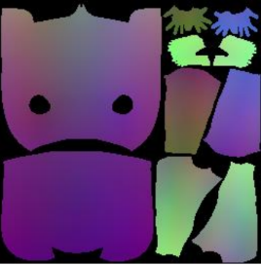
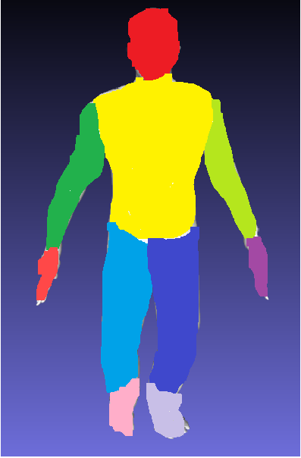
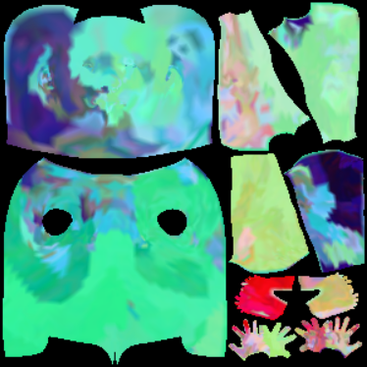

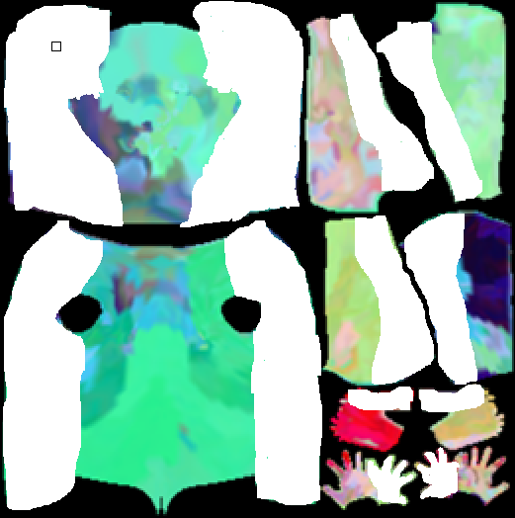
Aligned
UV Mapping
New Texture Inpainter
UV Mapping
Semantic conditioned inpainter

Slide 8
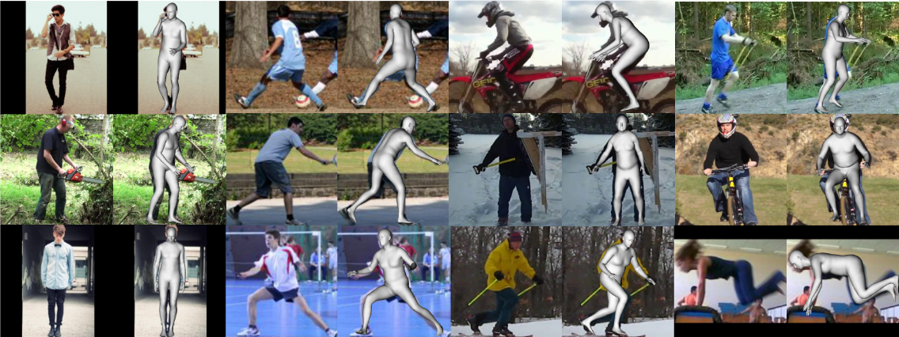
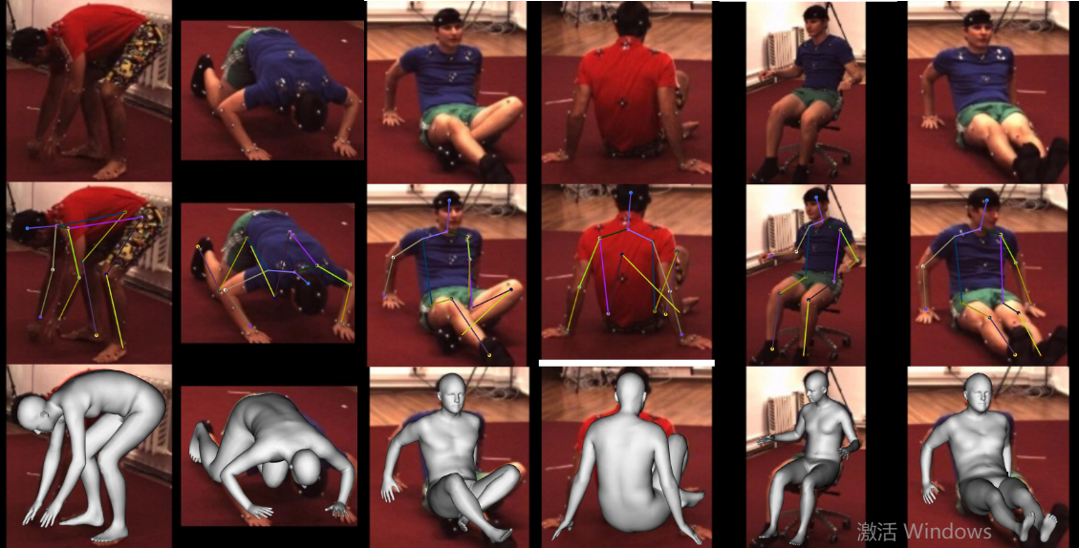
UP-3D
?
Dataset
Human3.6M→Mosh Dataset

Slide 9
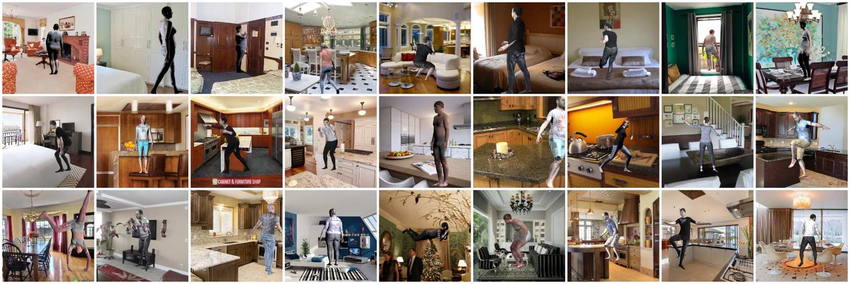
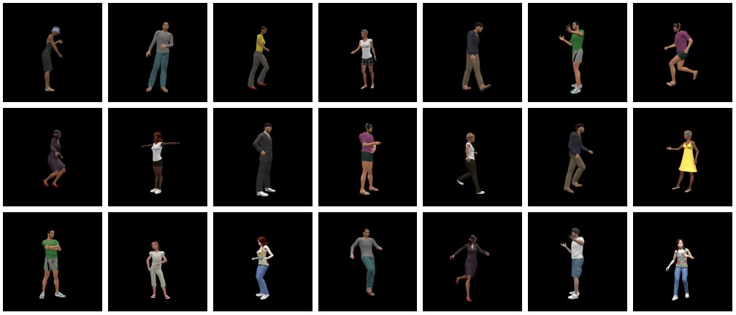
✔
Dataset
SURREAL: 1K clothings, 4K body shapes, 70K background images
PVHM: 10,200 pose-varying human mesh models, 22 different appearances, 200 to 1200 different poses.

Slide 10
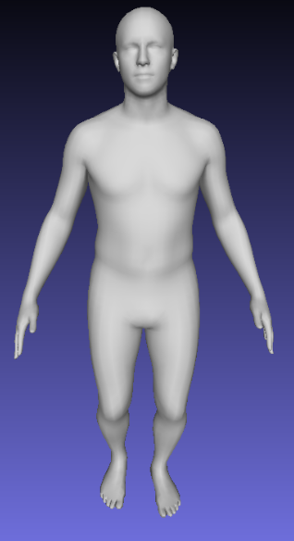
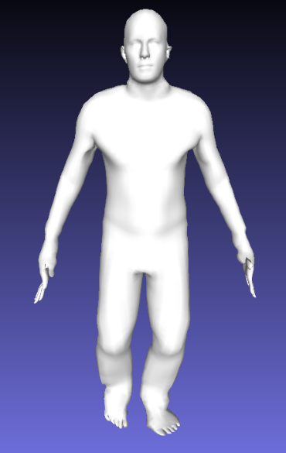
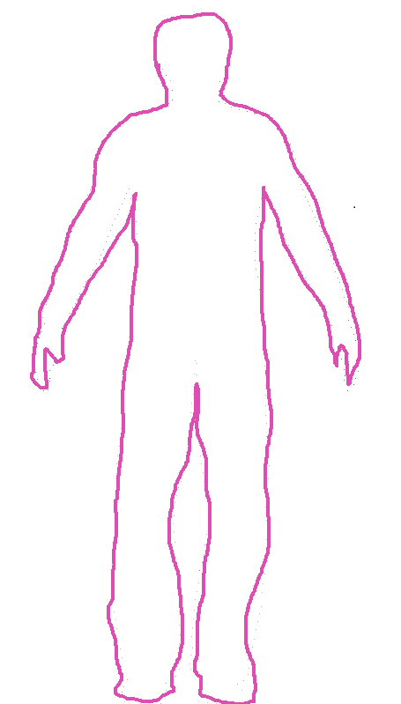
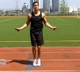
?
Middle-Level Details Recovery
Naked Body
Detailed Boundary
Detailed Body
Unsupervised
Deform
Aligned
UV Mapping
Parsing
Parsing
Supervised Training
UV Mapping
Semantic conditioned inpainter
Decoder
Encoder

Slide 11
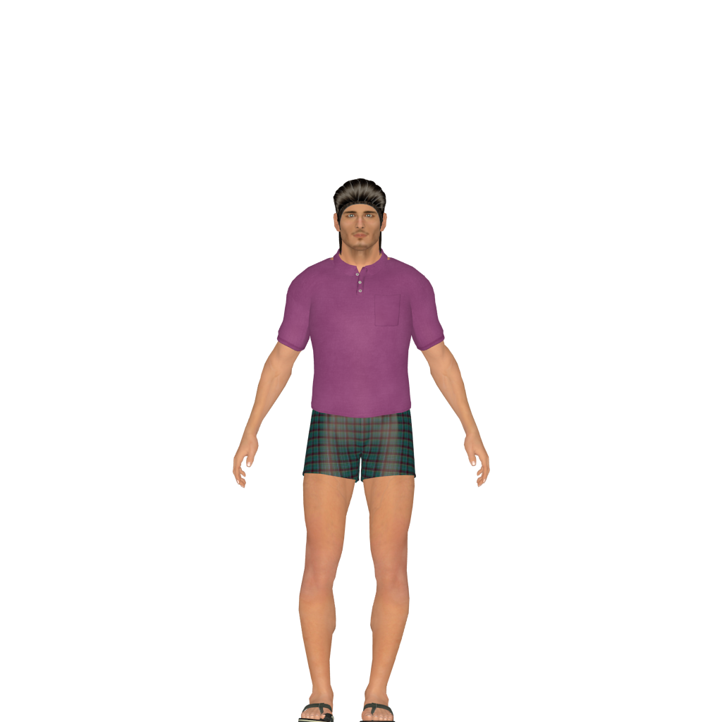
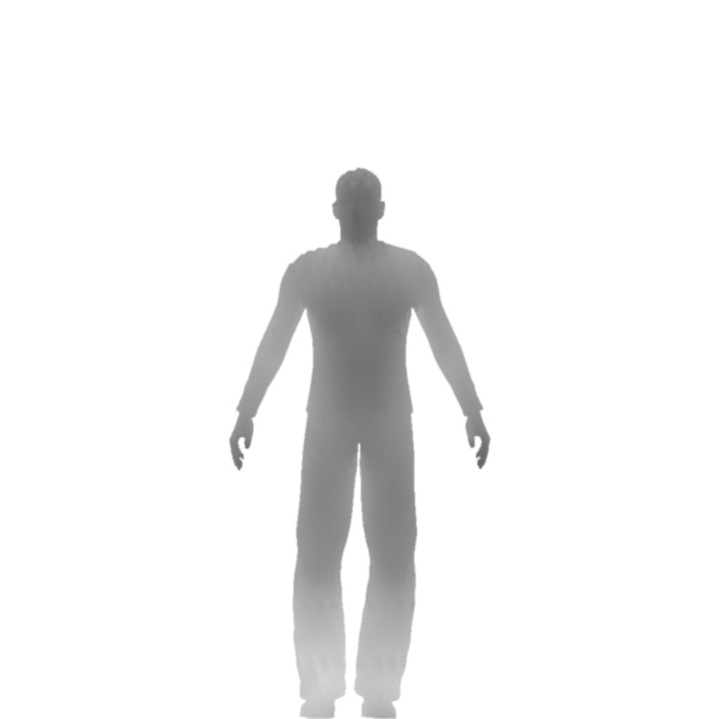
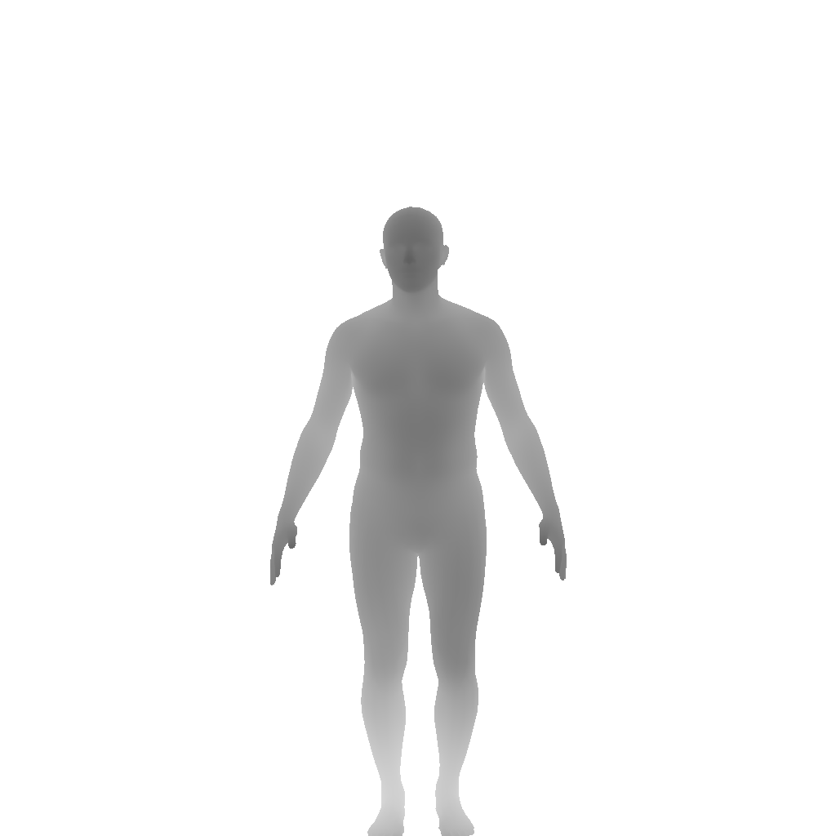
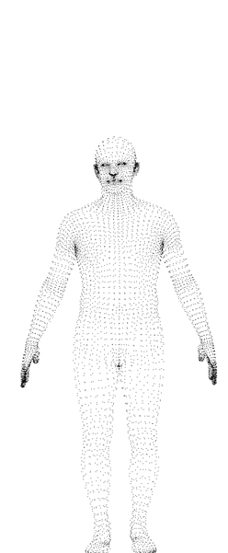
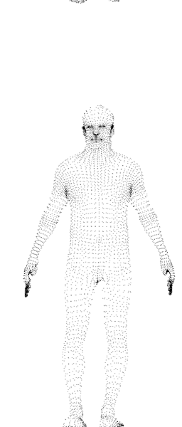
mean- value coordinates
M. S. Floater. Mean value coordinates. Computer aided geometric design, 20(1):19–27, 2003

Slide 12
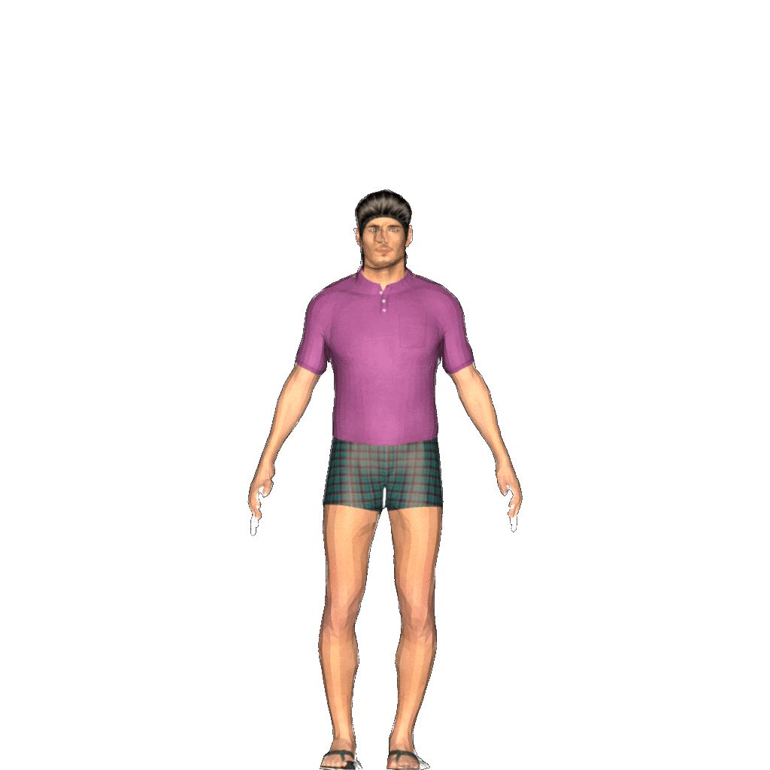

Slide 13
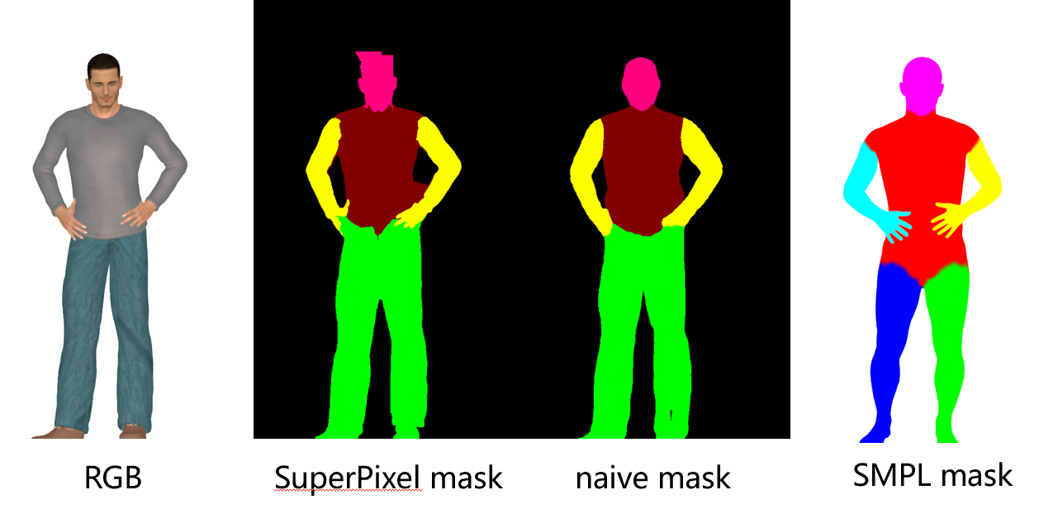
SuperPixel

Slide 14
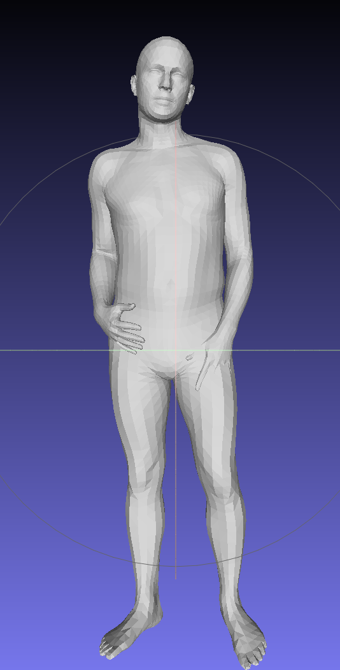
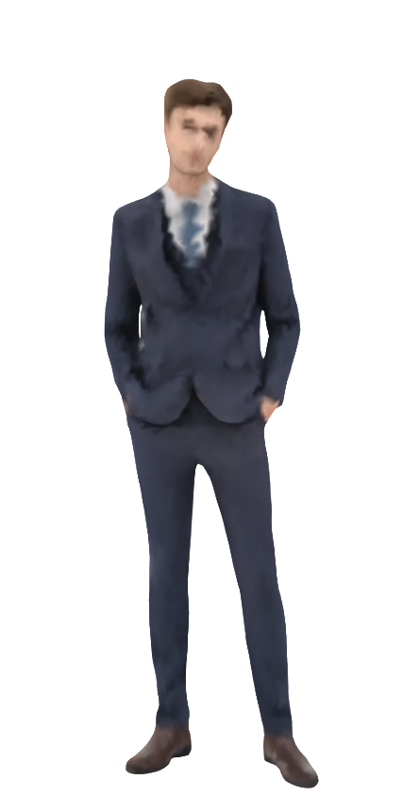
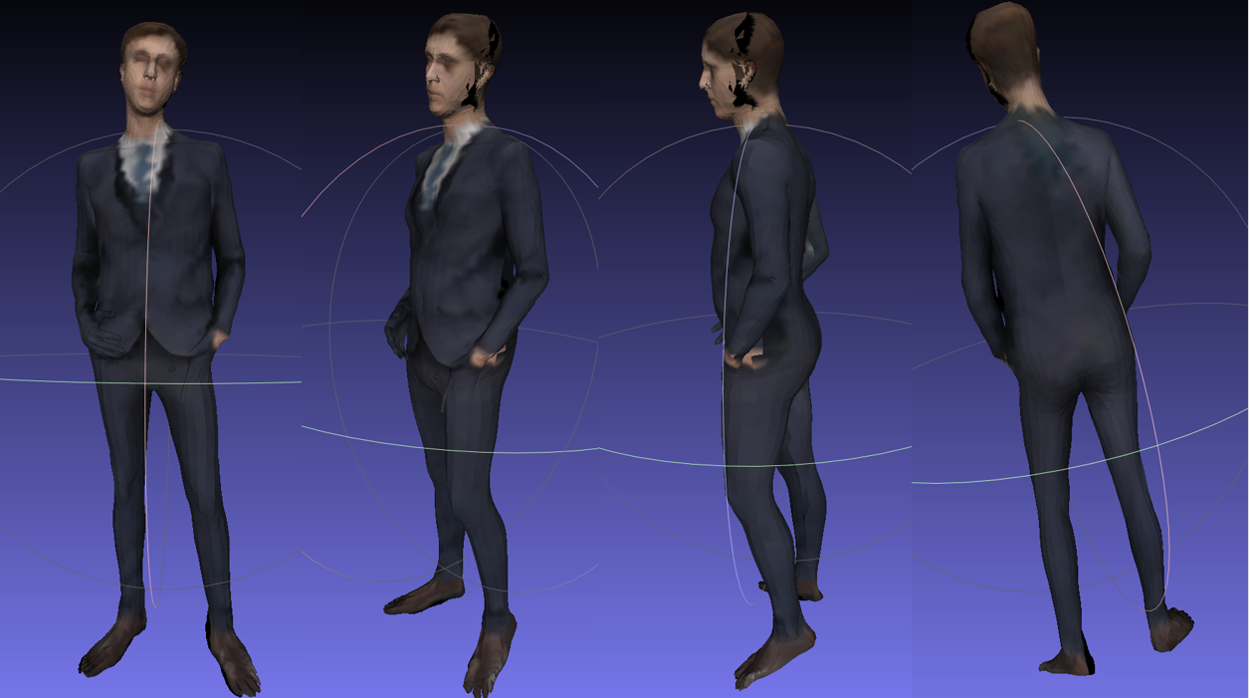
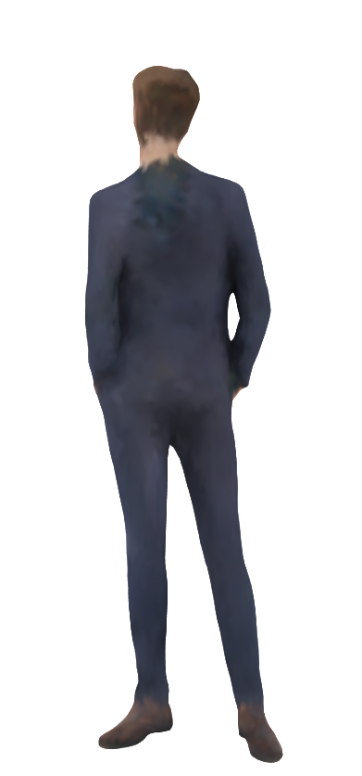

Slide 15
Future Work
3D Skeleton Estimation (derived from SMPL directly)
Forecasting Human Dynamics (with Motion Synthesis)
Human Shape Prior (for Human-Object Interaction)
Novel-View Synthesis (for Robotics Vision)

